Slide 1

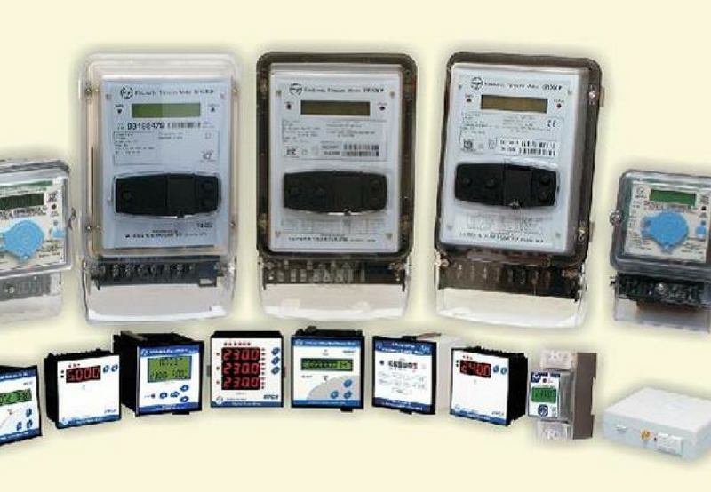
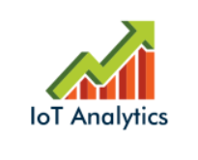
analysis of the energy consumption data
Asad Aftab
IoT Analytics

Slide 2

Agenda
Background
Visualizations
Linear Regression Forecast
Decomposition Visualization
Holt Winters Forecasting
Business Recommendations
Lessons Learned

Slide 3
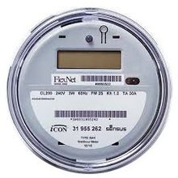
background
We at IoT Analytics have been working on analyzing the provided smart meter data to draw insights on power usage so that recommendations / suggestions can be provided.
This slide deck shows the results of the analysis.
Sub-Meter | Appliances
1 - Kitchen | Dish washer, Oven, Microwave
2 - Laundry | Washer, Dryer, Refrigerator, Light
3 – Misc. | Water heater, Air conditioner

Slide 4
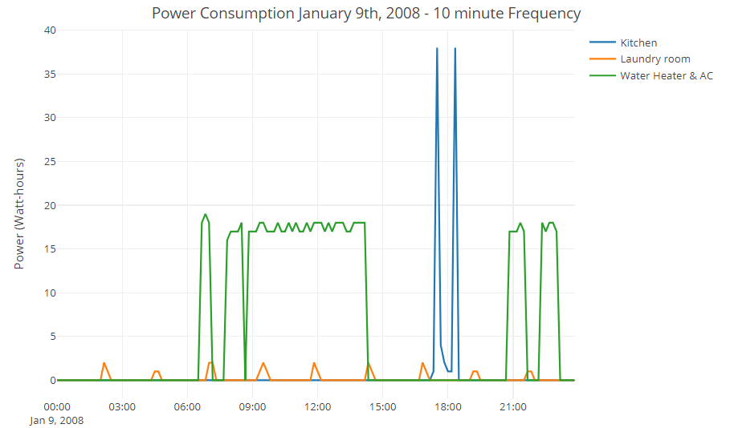
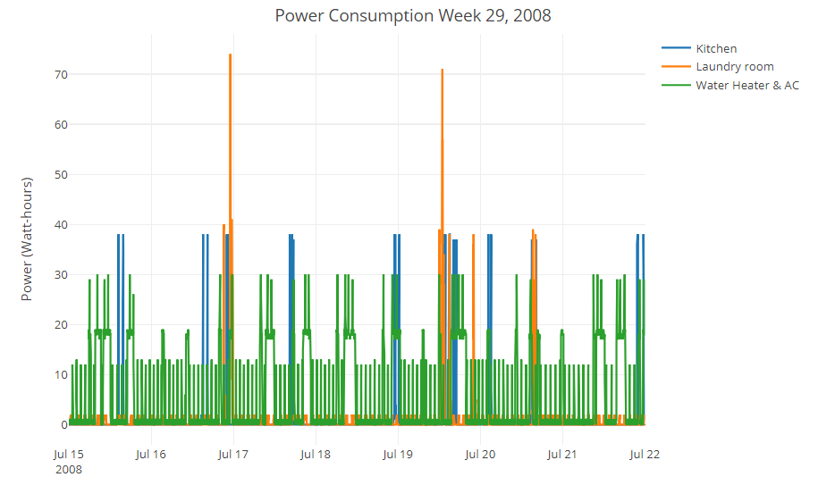
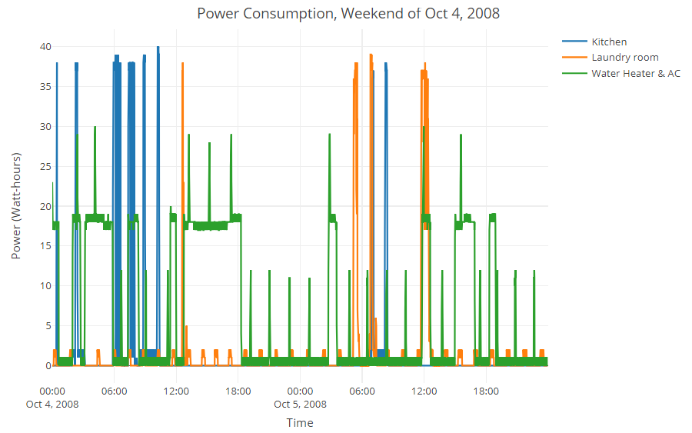
VISUALIZATIONS WITH ANALYSIS
The graphs above are for three periods of time in the year 2008 and captures usage for all three sub-meters. These charts can help the consumer see the peak and average usage and identify trends. The consumer can use these to adjust the power usage in line with the billing plan for e.g. shift heavy usage to weekend and off peak hours.

Slide 5
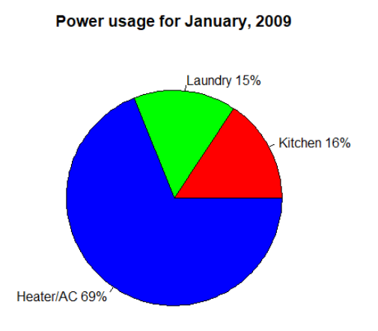
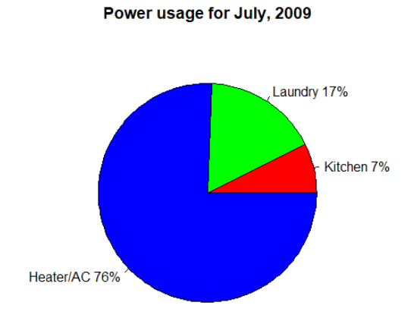
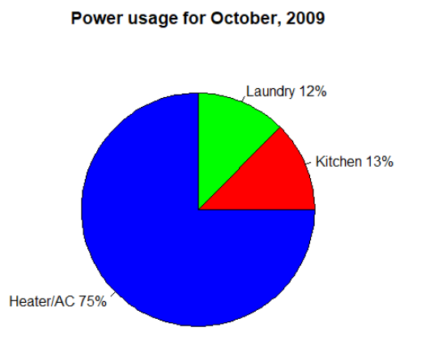
MONTHLY POWER USAGE BREAKDOWN
From above it is clear that water and AC dominates the power consumption. IoT analytics can provide the total power consumption and help determine if the consumer is using the most energy efficient appliances in terms of technology.
Consumer can also tally their monthly usage with the electric bill to find discrepancies.

Slide 6
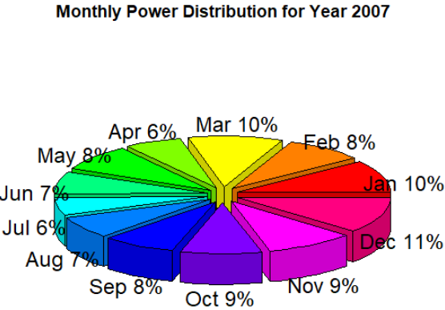
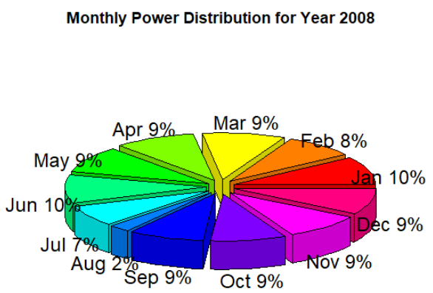
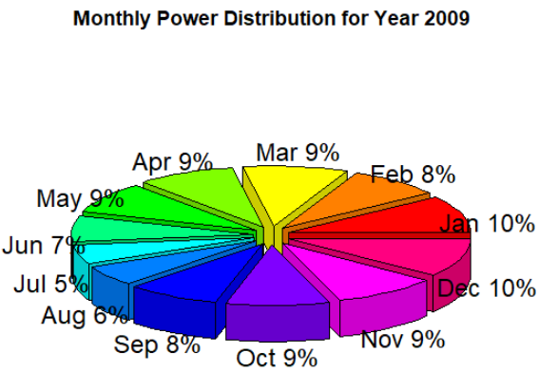
POWER DISTRIBUTION PER YEAR
Some important observations can be made from the above pie charts, for e.g. 2% power usage for August 2008 does not compare with August usage for 2007 or 2009 and points towards either missing data for August 2008 or the home being empty for part of the month – datafile can be inspected or queried to confirm if this is the case of missing data.
Lowest usage seems to be in the summer months perhaps due to lack of AC meaning it is not too hot in the region from where this data was collected – this can be confirmed by checking the sub-meter 3 during those months.

Slide 7
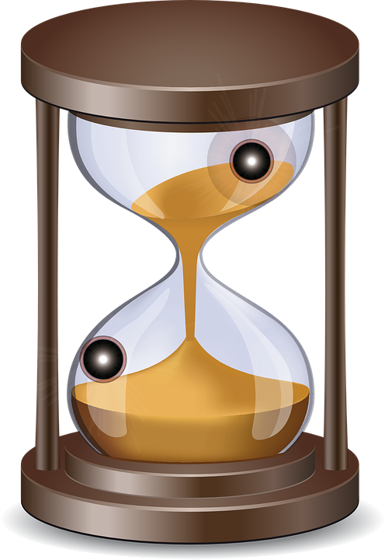
TIME PERIODS SELECTED for ANALYSIS
Sub-meter 3 (Water heater / AC)
Time series period used: Mondays 8:01 pm, duration one minute for years 2007 – 2009
Sub-meter 2 (Laundry)
Time series period used: Saturdays 1:00 pm, duration one hour for years 2007-2009
Sub-meter 1 (Kitchen)
Time series period used: All days 6:30 pm, duration one minute for years 2007-2009

Slide 8
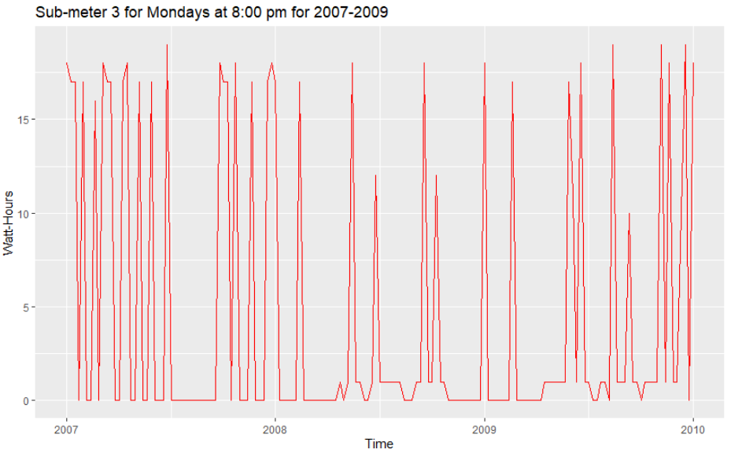
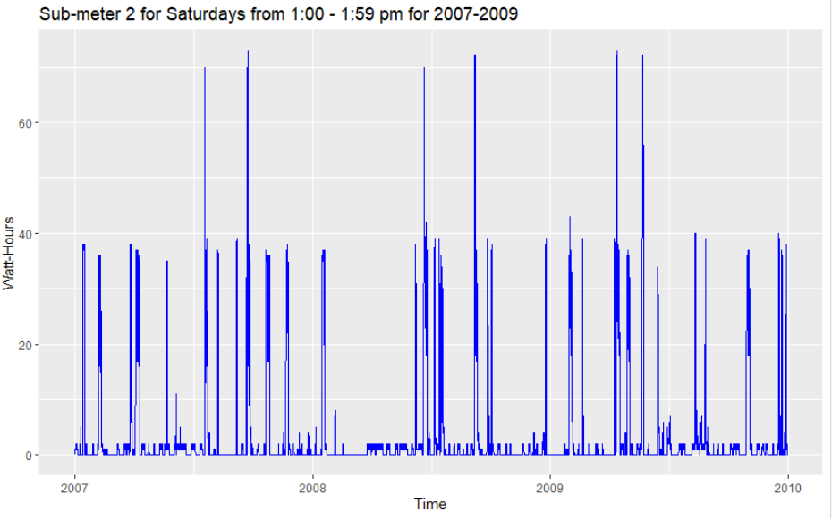
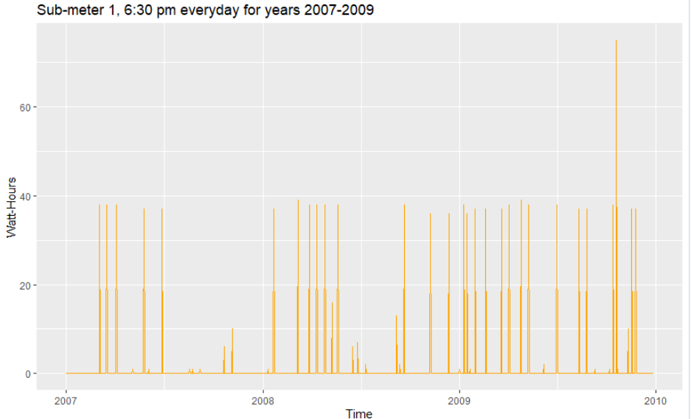
TIME SERIES VISUALIZATIONS
Time series analysis is the collection of data at specific intervals over a period of time, with the purpose of identifying trends, cycles, and seasonal variances to aid in the forecasting of a future event or usage.
The above charts are for three time periods that repeats for years 2007,2008,2009.
As shown above the power usage is following the expected course i.e. cyclical usage. We will use this analysis to forecast future usage into year 2010

Slide 9
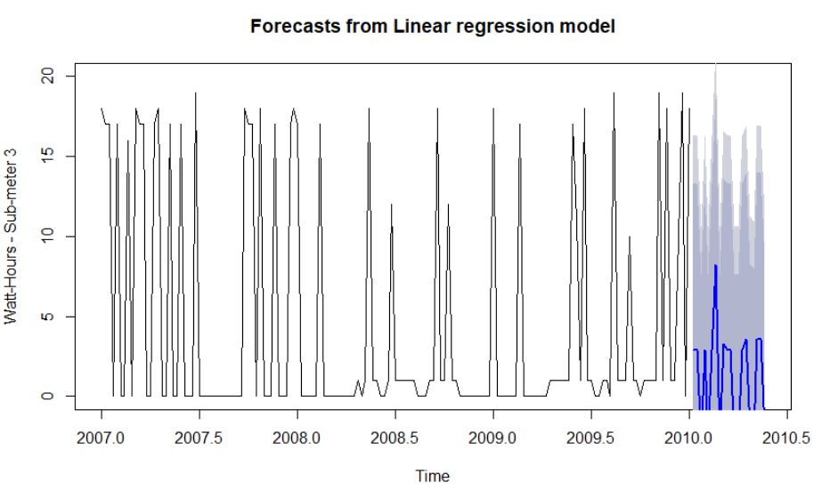
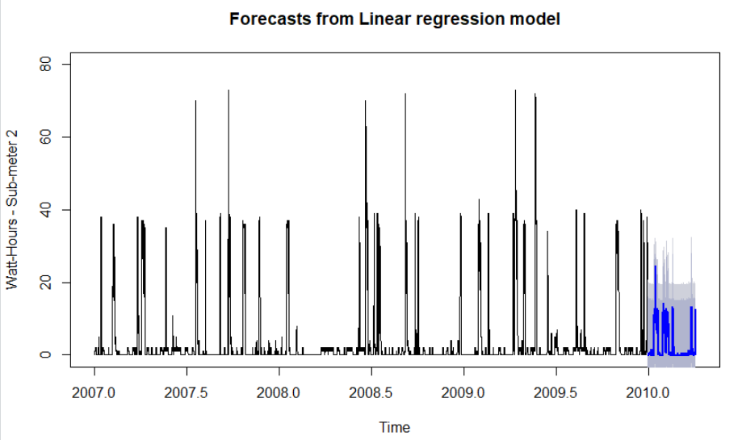
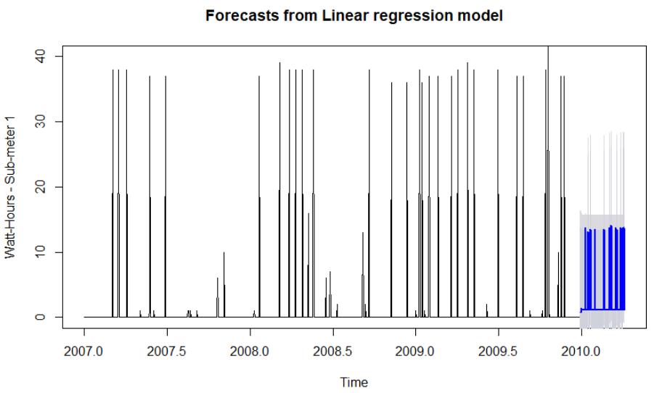
LINEAR REGRESSION FORECAST
Using the same time periods as in the previous slide on time series visualization we used linear regression forecast to create the above charts. Note the forecasted power usage in the blue lines and the shaded area.
Forecasts help peak into the future and determine upcoming power usage.

Slide 10
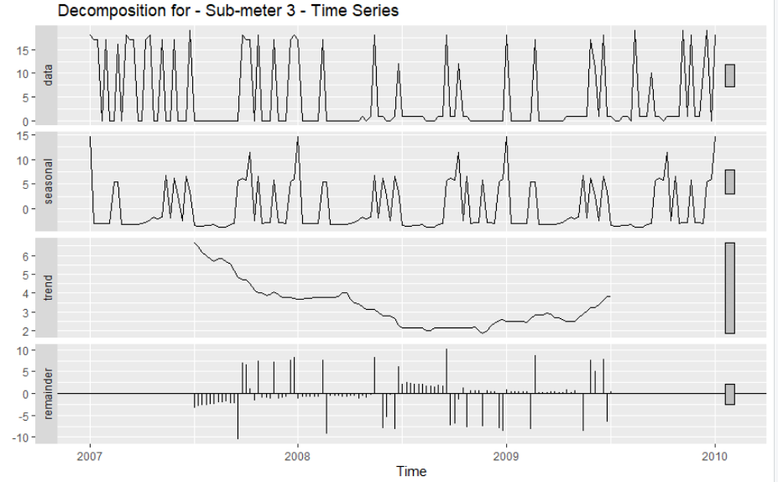
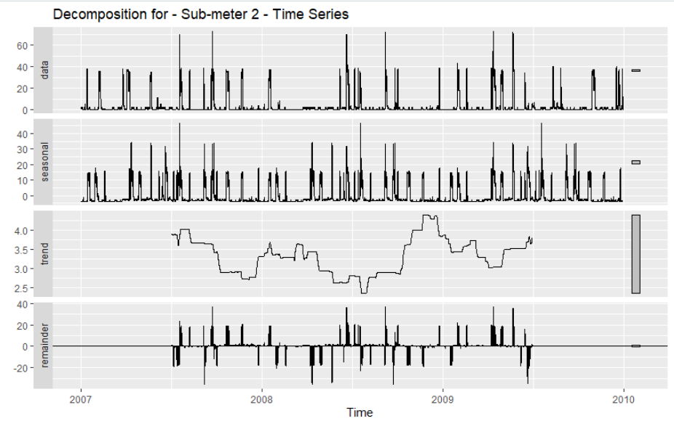
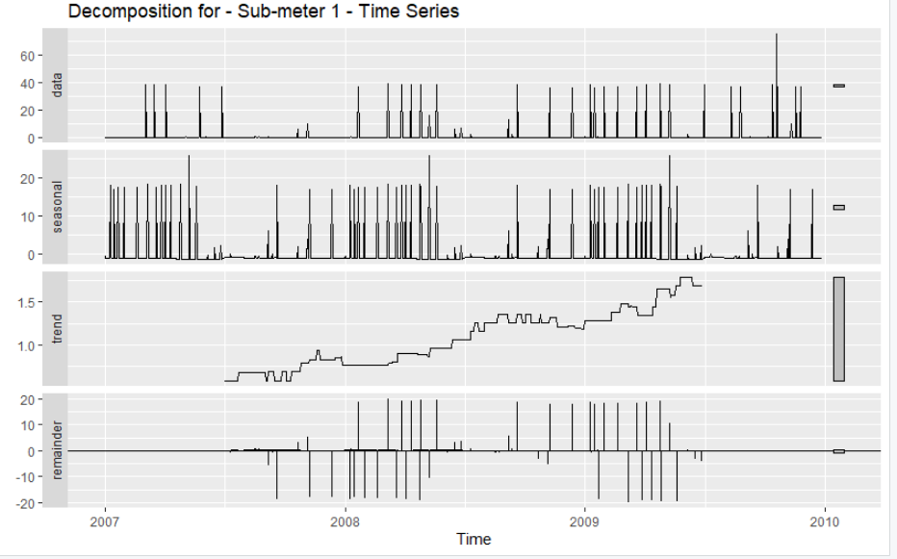
DECOMPOSITION VISUALIZATION
There are three components of a decomposed time series: trends shows the behavior over a period of time, seasonal component repeats with regular intervals and remainder component aka random are irregular fluctuations that cannot be predicted.
The trend and seasonal information can help the consumer better understand their power usage and also be prepared for upward or downward trends.

Slide 11
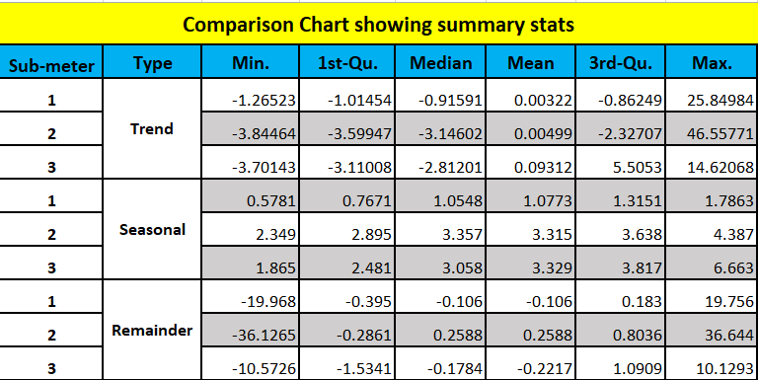
COMPARISON CHART
Summary statistics were collected for each decomposed object and trend, seasonal and remainder components for each sub-meter were compared in the shown chart.
This is not an accurate comparison since different frequencies and time periods were used for each sub-meter.

Slide 12
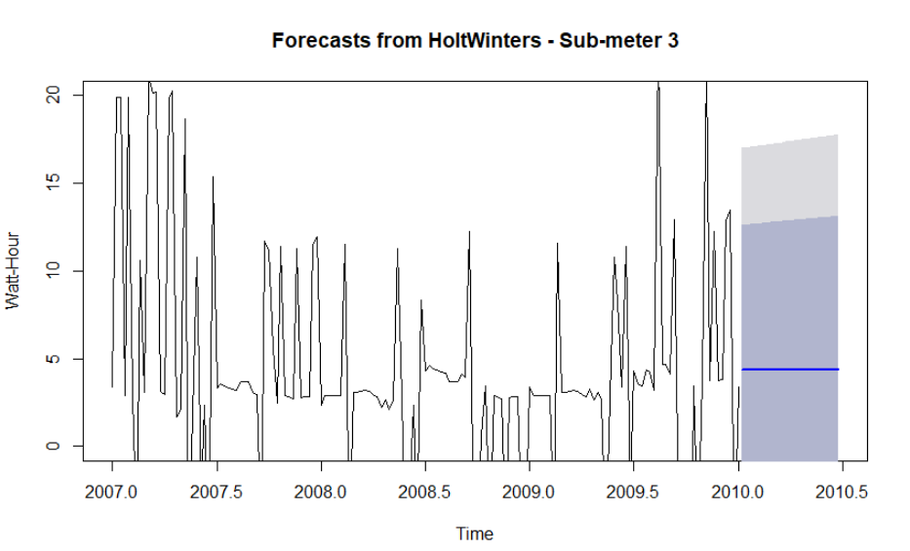
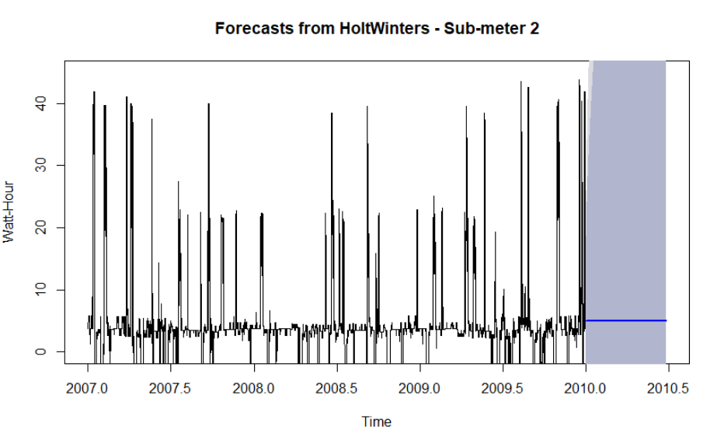
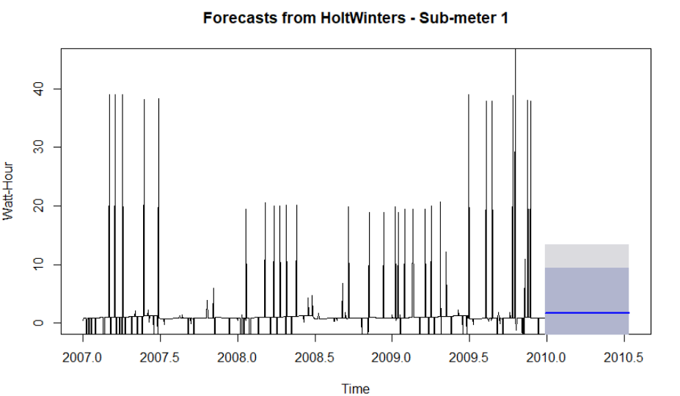
HOLT WINTERS FORECASTING
HoltWinters function was used to smoothen the forecast via exponential operation. The dark blue and light blue area above shows the forecasted power consumption.
Please note, the seasonal component was removed to predict accurate usage.

Slide 13
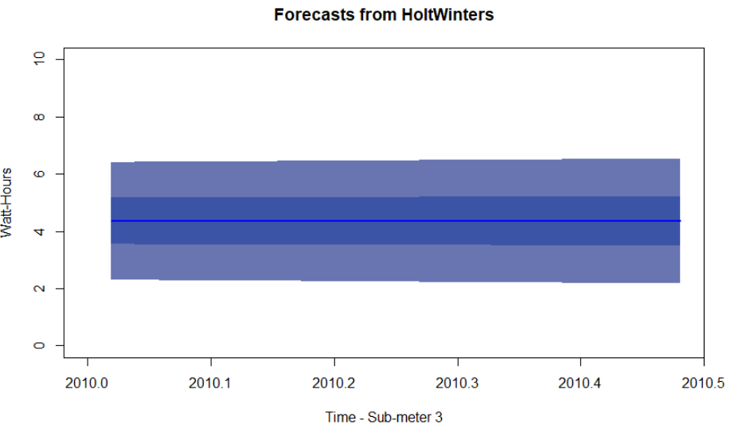
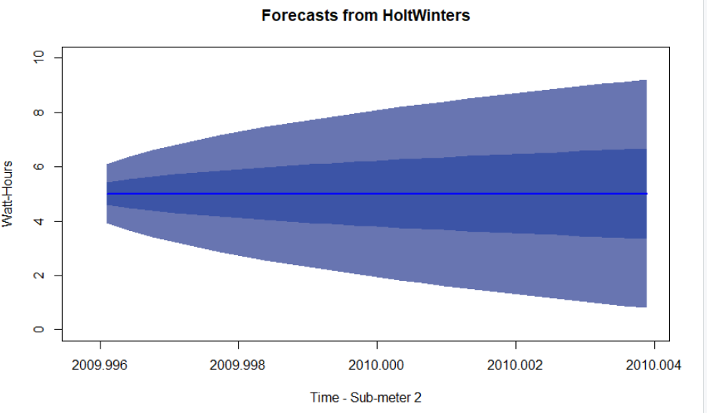
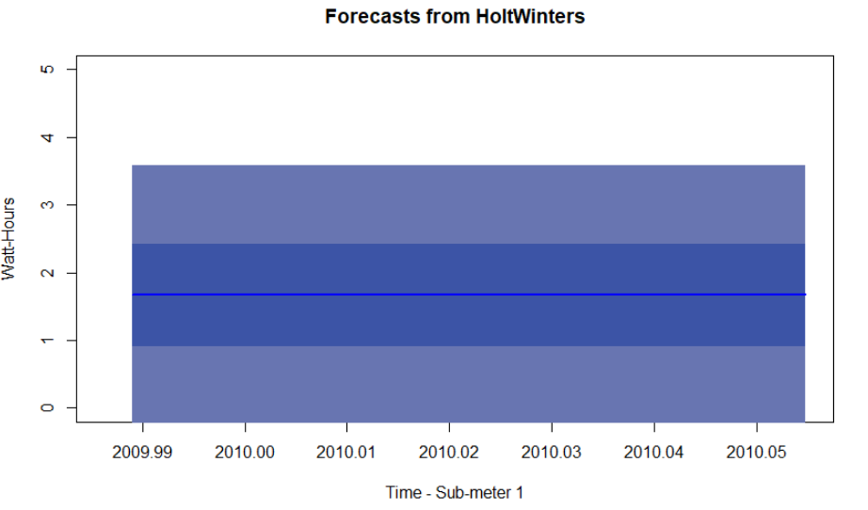
HOLTWINTERS – FORECASTED AREA
Above charts show the forecasted area for HoltWinters function.
The blue line is the center point. Dark blue region is the confidence interval. Light blue region is the higher confidence interval. Forecasted values can fall anywhere in the confidence intervals.
Sub-meter 3 and 1 above shows a consistent forecast with no major change from current usage while sub-meter 2 is showing uncertain forecast in the future as confidence becomes broader (funnel shape)

Slide 14
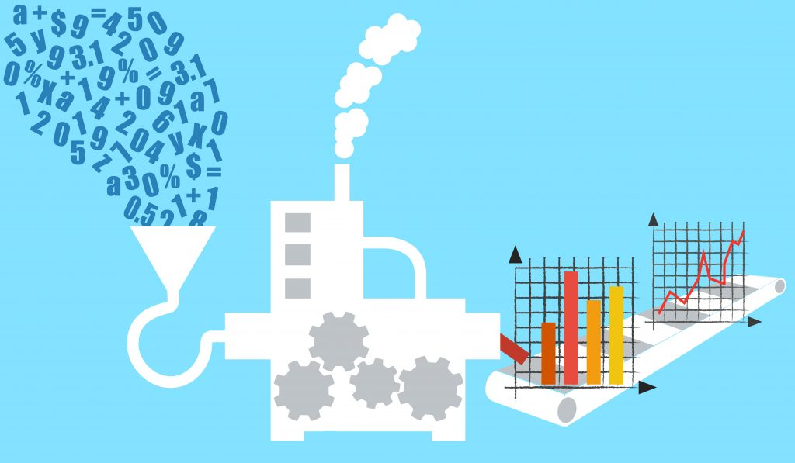
summary
The raw data by itself is not useful.
It can be put to good use by using the techniques of data analytics, forecasting and visualization.
IoT Analytics team has shown the value of provided data via powerful analysis.
The results have been put together in easy to understand graphs and charts.
The goals of the project has been met.
We are ready, prepared and look forward to other future project with the home builder client.

Slide 15

BUSINESS RECOMMENDATIONS
Data analysis and visualization can aid consumer by providing power usage details in easy to understand format for any custom duration up to a minute for e.g. lower the AC use while no one is at home.
Aggregation of data on a monthly basis can help tally the usage with the monthly bill.
Time series analysis and forecasting can show data trends and help predict the future usage.
One application for this study is monitoring: Set alarms, logs, notifications for the consumer at different thresholds.
Analysis of seasonality component can help explain and predict low and high usage during certain times of the year.
Power consumption for appliances can be analyzed to decide if it is worth to switch to more energy efficient appliances.

Slide 16

LESSONS LEARNED
IoT based analytics is a powerful tool in the hands of the smart meter devices consumer.
Data analyst should learn and master the different visualization functions available as these provide a quick and powerful way of conveying results to the management team.
Time Series analysis is a useful tool for cyclical data and it helps predict / forecast the future usage as well.
Try multiple methods, models, durations, frequencies and confidence levels and pick the ones providing most and useful information.
In addition to R and PowerPoint be familiar with other tools to help create smart reports for e.g. Excel

Slide 17
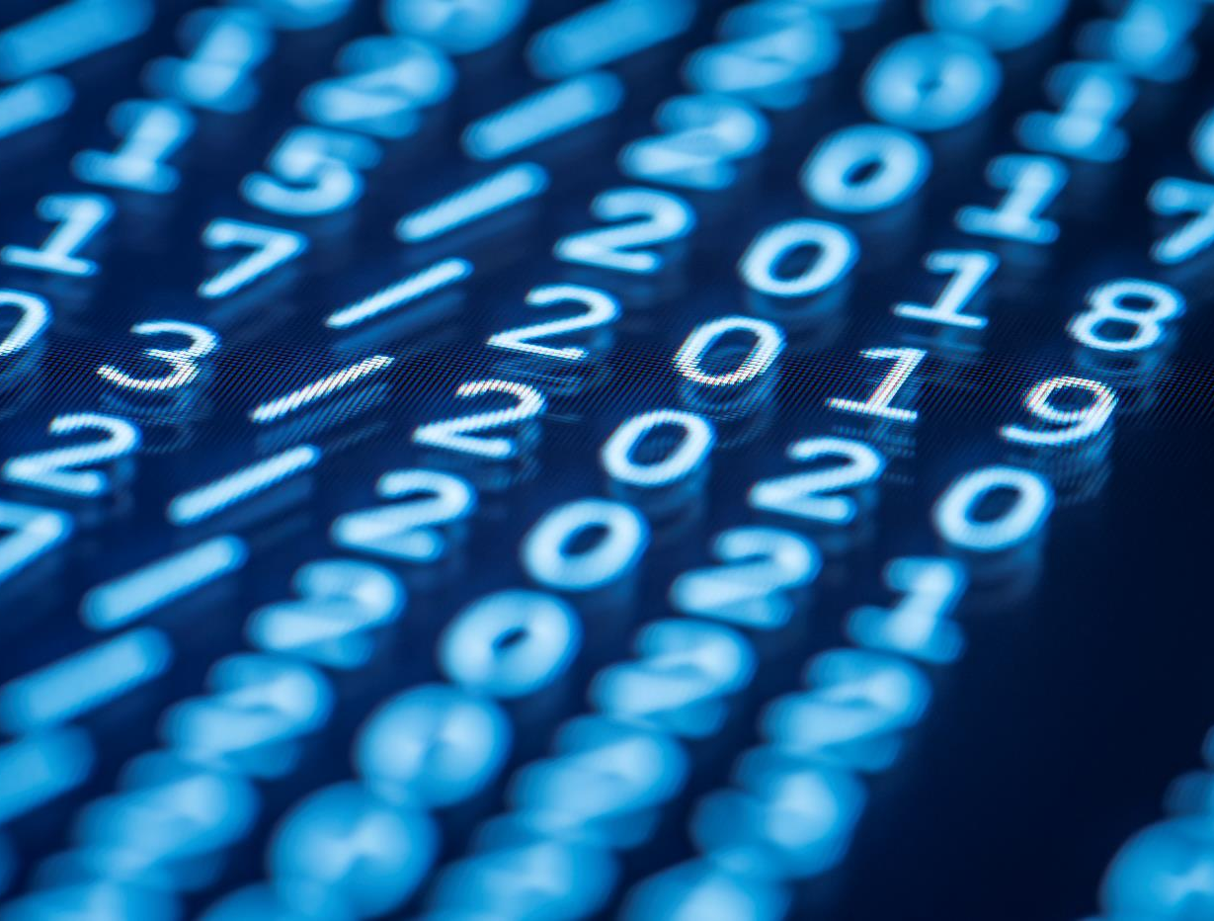
Thank You

